Slide 1
“Be fearful when others are greedy – and be
Greedy when others are fearful”

Slide 2
Credit During the “Crunch” How to Thrive while others are trying to Survive!

Slide 4
March 24, 2006

Slide 6
When !
HOW !

Slide 7
The “When” Department

Slide 8
Credit 101

Slide 9
1. Past Delinquencies…
35%
of
Credit Score

Slide 10
2. Revolving Debt Ratio…
30%
of
Credit Score

Slide 11
3. Average Age of Credit File…
15%
of
Credit Score

Slide 12
4. Mix of Credit …
10%
of
Credit Score

Slide 13
5. Inquiries…
10%
of
Credit Score

Slide 14
Credit Score Components
Past Delinquencies
Debt Ratio
Average Age of File
Mix of Credit
Inquiries

Slide 15
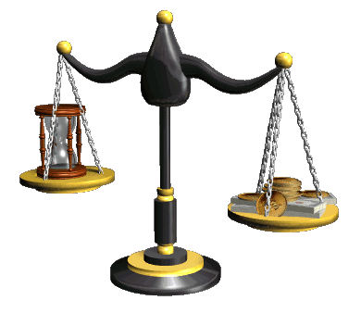
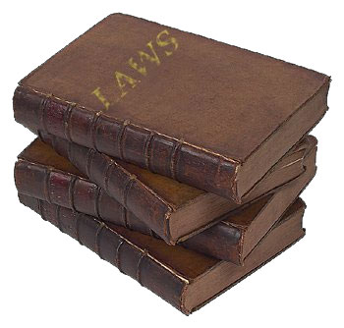
100% Accurate
100% VERIFIABLE
Timely

Slide 16
Credit Myths
"The credit bureaus are government agencies"

Slide 17
Credit Myths
“Opting out????”
www.OptOutPrescreen.com

Slide 18
Credit Myths
"Checking my own credit report harms my credit score"

Slide 19
Credit Myths
“My Lender can use the credit report I obtained from Annual Credit Report”

Slide 20
Credit Myths
“Your income makes a difference in your credit score”

Slide 21
Credit Myths
“FICO scores are locked in for six months, and that they change every six months”

Slide 22
Credit Myths
“Too many accounts will hurt, therefore you must close accounts.”

Slide 23
Credit Myths
“Paying off an old collection or charge off will increase your credit score”

Slide 24
Credit Myths
"As long as you pay off your credit card balances, your score will go up"

Slide 25
Credit Myths
“Adding a consumer statement to your credit file makes a difference”

Slide 26
Credit Myths
"If I get one credit bureau to remove an item from my credit report, all the other bureaus will remove it automatically”

Slide 27
Credit Myths
“Multiple auto loan inquiries increase will hurt your score for each one”

Slide 28
Credit Myths
“It will take me seven years to improve my credit”

Slide 29
100% Accurate
100% VERIFIABLE
Timely

Slide 30
INSERT PROOF

Slide 31
Success with Original Creditor
JUDGMENT
Direct FCBA letter to CITI coupled with letters to each bureau removed a Judgment from 3 bureaus.
Notes:
read letter

Slide 32
Success with Credit Bureaus
Bankruptcy deleted
BANKRUPTCY
Notes:
read letter

Slide 33
But… how does it work?

Slide 34
Web Based Portal

Slide 35
View Clients in Progress

Slide 36
View Client Status 24/7

Slide 37
Communication

Slide 38
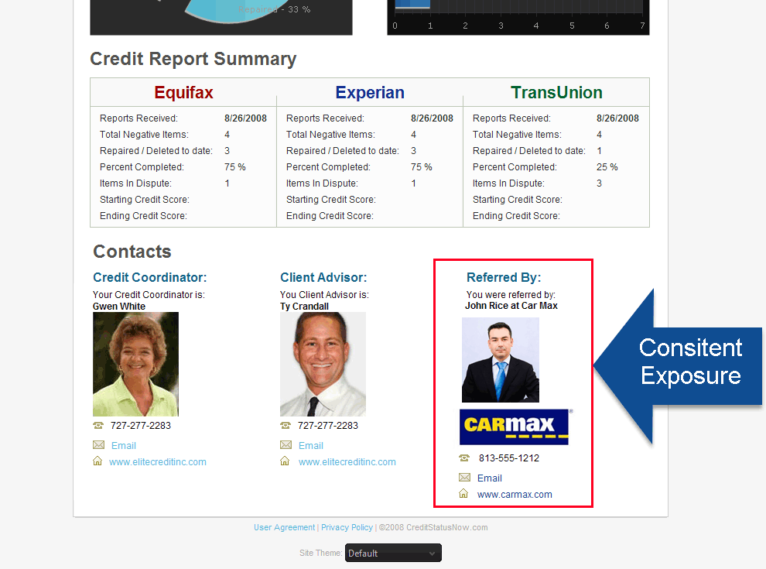
Consistent Re-Marketing

